Slide 1
Parallel Computing
Ekkapot Charoenwanit
Software Systems Engineering
TGGS
KMUTNB

Slide 2
Lecture 8:
Shared-Memory Programming with OpenMP
OpenMP Tasks

Slide 3
OpenMP: Tasks
OpenMP tasks provide a new parallel programming paradigm
called the work-oriented paradigm
based on the concept of a task pool
In this work-oriented paradigm, units of work (referred to as OpenMP tasks)
are generated or “pushed” into the task pool by threads
are retrieved or “pulled” off the task pool and executed by threads

Slide 4
OpenMP: Tasks
In classic OpenMP, threads are treated as a fundamental concept:
The thread-centric paradigm
The OpenMP standard prior to 3.0 described semantics in terms of threads.
In the work-oriented paradigm, we focus on units of work referred to as tasks:
We must now think how the code and data can be broken into units of work that can be executed in parallel, i.e., tasks.
We can think of a task as
code
data (Data Environment)
internal control variables (ICVs) [implementation details]
packaged up as an independent schedulable unit.

Slide 5
OpenMP: Tasks
Threads are assigned to perform the work of each task:
Tasks may be deferred.
Tasks may be executed immediately.
Tasks enable irregular and recursive computational problems to be parallelized in a natural way, e.g.,
Traverse a linked list while performing work on each node in parallel
Implement parallel recursive algorithms

Slide 6
OpenMP: Tasks and Threads
A task is a specific instance of Executable Code and its Data Environment that can be scheduled for execution by a thread.
Each encountering thread creates a new instance of a task, e.g. code and data.
Tasks can be deferred ,i.e., they do not need to be executed immediately.
If a task is deferred, some thread in the team executes the task at some time later.
The encountering thread that generated a task is not necessarily the same thread that will eventually execute the task.
Tasks bind to the corresponding innermost enclosing parallel regions.

Slide 7
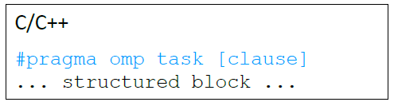
OpenMP: Task Creation
Tasks are created when
when a #pragma omp parallel is reached
implicit tasks are created per thread
when a #pragma omp task is encountered
an explicit task is created
when a #pragma omp taskloop is encountered
explicit tasks per chunk are created
when a #pragma omp target is encountered
A target task is created

Slide 8
OpenMP: Task Creation and Execution
Thread
Generates tasks
Thread
Thread
Task Pool
Thread
Thread

Slide 9
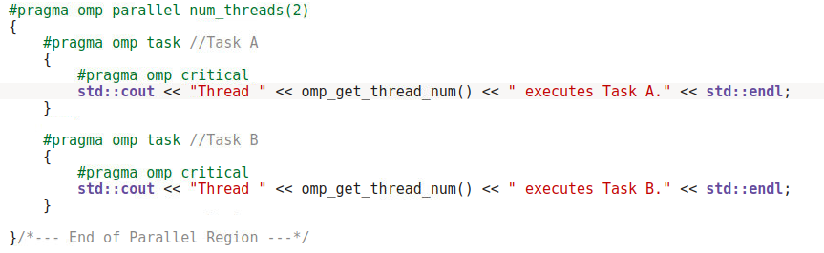

OpenMP: Task Creation and Execution
Each thread in #pragma omp parallel creates a new task.
It is non-deterministic which threads are to execute which tasks.

Slide 10
OpenMP: Task Creation and Execution
Each thread inside #pragma omp parallel pushes two tasks to the task pool, i.e., four tasks are pushed to the task pool in total.
There is an implicit barrier at the end of #pragma omp parallel, which acts as a task synchronization construct.

Slide 11
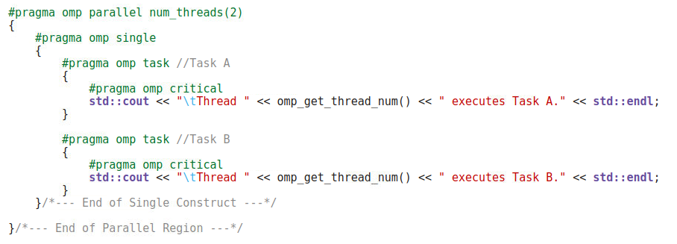

OpenMP: Task Creation and Execution
One of the two threads generates Task A and Task B.
It is non-deterministic which threads are to execute which tasks.

Slide 12
OpenMP: Task Creation and Execution
One of the two threads inside #pragma omp parallel is in charge of enqueuing tasks to the task pool.
There is an implicit barrier at the end of #pragma omp single, which acts as a task synchronization construct.
The nowait clause can be used on #pragma omp single to remove the implicit barrier.

Slide 13
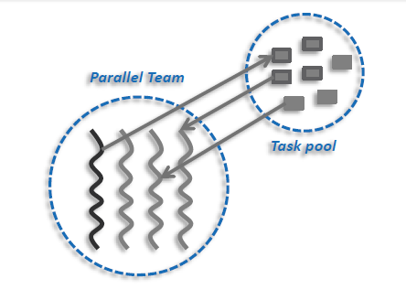
OpenMP: Task Execution Model
Task Creation:
OpenMP tasks can be created using the following task creation patterns:
Single Task Creator
with #pragma omp single
with #pragma omp master
Multiple Task Creators
Nested Tasks
Task Execution:
All threads in the team are candidates to execute tasks:
deferred
Immediately executed
Figure Credit: C. Terboven PPCES 2021

Slide 14
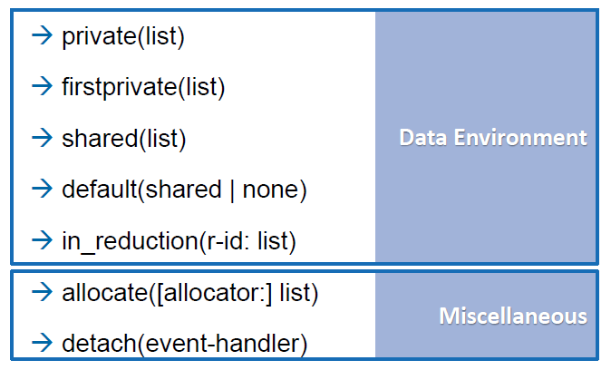
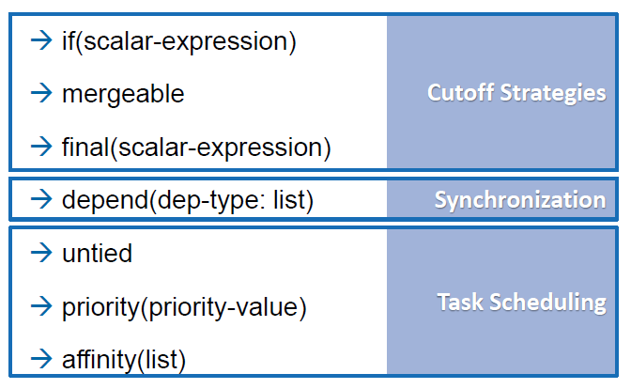
OpenMP: Task Clauses
Figure Credit: C. Terboven PPCES 2021

Slide 15
OpenMP: Data Environment
The Data Environment consists of all the variables associated with the execution of a given task.
Because tasks can be deferred, the data is “captured” at task creation.
The semantics of data scopes are adapted to deferred execution as follows:
For a shared variable, the reference to the shared variable within the task is to the memory location to that name at the time where the task was created.
For a private variable, the reference to the private variable within the task is to new uninitialized storage that is created when the task is executed.
For a firstprivate variable, the reference to the firstprivate is to new storage that is created and initialized with the value of the existing memory of that name when the task is created.
Capturing data structures with firstprivate captures only the pointer but not the pointed data.

Slide 16
OpenMP: Data Environment
Data-Scoping Rules: Most rules from #pragma omp parallel still apply.
Pre-determined data-sharing rules for #pragma omp task:
Static and global variables are shared.
Static local variables are shared.
Automatic (local) variables are private.
Threadprivate variables are threadprivate.
The data-sharing attributes of variables that are not listed in any data-sharing clauses of #pragma omp task and are not pre-determined according to the rules above, are implicitly determined as follows:
Implicit data-sharing rules for #pragma omp task:
The shared attribute is lexically inherited.
In any other case, the variable is firstprivate.

Slide 17
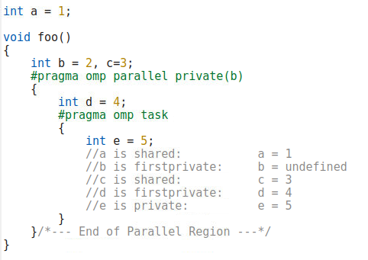
OpenMP: Data Environment
In #pragma omp parallel, c is shared by default
In #pragma omp task, the data scoping of c is lexically inherited, i.e., c is shared.
In #pragma omp parallel, a is shared by default since it is a global variable.
In #pragma omp task, the data scoping of a is lexically inherited, i.e., a is shared.

Slide 18
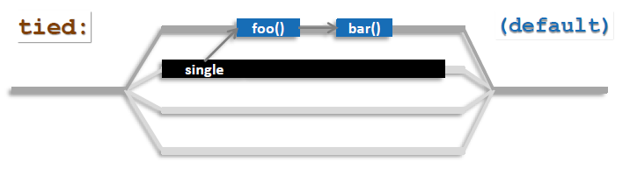
OpenMP: Task Scheduling
Tasks can be either tied or untied:
Tasks are tied by default unless the untied clause is explicitly placed on #pragma omp task.
Tasks remain tied to the threads that first execute them.
A tied task is always executed by the same thread:
The tied task must be executed by the same thread throughout its entire life cycle.
The thread that executes the tied task does not have to be the same thread that created the task.
Tied tasks can restrict scheduling decisions and may, therefore, negatively impact performance.
Figure Credit: C. Terboven PPCES 2021

Slide 19
OpenMP: Task Scheduling
In addition to explicit tasks specified with #pragma omp task, OpenMP has also the notion of implicit tasks.
An implicit task is one that is implicitly created when a parallel construct specified with #pragma omp parallel is encountered.
Each implicit task is assigned to a different thread in the team and remains tied to that thread throughout the entire life cycle of the task.

Slide 20
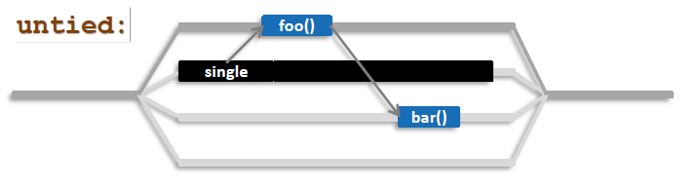
OpenMP: Task Scheduling
The scheduling constraint can be relaxed using the untied clause:
An untied task can migrate between any threads in the team.
An untied task must be avoided when used with thread-centric features such as
Thread ID
Threadprivate Data
The OpenMP runtime has greater flexibility in scheduling tasks.
can potentially provide better load-balancing
Figure Credit: C. Terboven PPCES 2021

Slide 21

OpenMP: Task Scheduling
Task Scheduling Points (TSP):
Tasks can be suspended and resumed at TSPs.
Implicit TSPs are included at the following locations:
Task creation
the point of encountering #pragma omp task
Task synchronization
The point of encountering #pragma omp taskwait
The end of #pragma omp taskgroup
The completion point of a task
The point of encountering an implicit or an explicit barrier
Explicit TSPs can be specified using #pragma omp taskyield.

Slide 22
OpenMP: Task Scheduling
At a TSP, a thread that is executing a Task A may
suspend the current Task A temporarily
AND
switch to execute a different Task B
With task scheduling, a thread can
execute an already created task to drain the task pool
To prevent the data structures for managing tasks from overflowing
execute the encountered task immediately instead of deferring the task

Slide 23
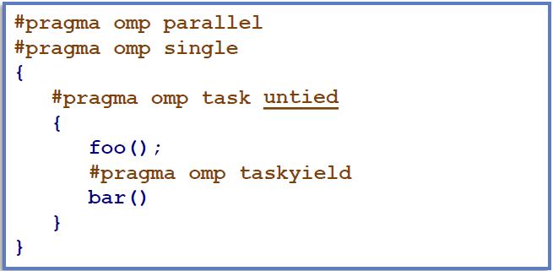
OpenMP: Task Scheduling
The taskyield directive explicitly specifies that the current task can be suspended in favor of a different task:
The OpenMP implementation may take this directive only as a hint.
So it might be implemented as a nop ☹.
Figure Credit: C. Terboven PPCES 2021

Slide 24
OpenMP: Task Scheduling
Caveat with threadprivate and thread-specific information:
When a thread encounters a TSP, the OpenMP implementation may choose to suspend the current task and schedule the thread to work on another task.
This implies that the value of a threadprivate variable or other thread-specific information, e.g. Thread ID, can potentially change across a TSP.
If the suspended task is a tied task, then the thread that resumes executing the task is guaranteed to be the same thread that suspended it.
The Thread ID will remain the same after the task is resumed.
If the suspended task is an untied task, the thread that resumes executing the task may be different from the thread that suspended it.
Both the Thread ID and the value of a threadprivate variable before and after the TSP may be different.

Slide 25
OpenMP: Task Scheduling
Let’s sum up the concept of tiedness and untiedness.
When a thread encounters a TSP, it may do one of the following:
it may begin execution of a tied task bound to the current team
it may resume execution of any suspended tied task, bound to the current team, to which it is tied.
it may begin execution of an untied task bound to the current team
it may resume execution of any suspended untied task bound to the current team
If more than one of the above choices is available, it is unspecified as to which option will be chosen by the OpenMP runtime.

Slide 26
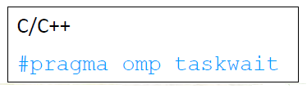
OpenMP: Task Synchronization
All tasks created by any thread of the current team are guaranteed to have completed at a barrier (implicit or explicit).
Explicit barrier : #pragma omp barrier
Implicit barrier : at the end of
#pragma omp parallel
#pragma omp for
#pragma omp single
etc.
A task that encounters #pragma omp taskwait is suspended until all child tasks complete.
applies only to child tasks, not all descendant tasks !!!
provides shallow task synchronization.

Slide 27
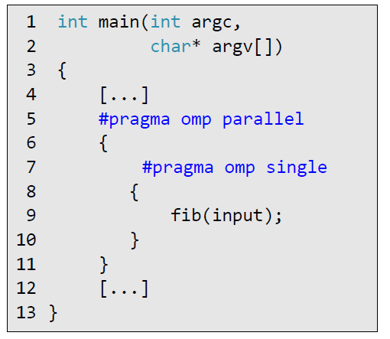
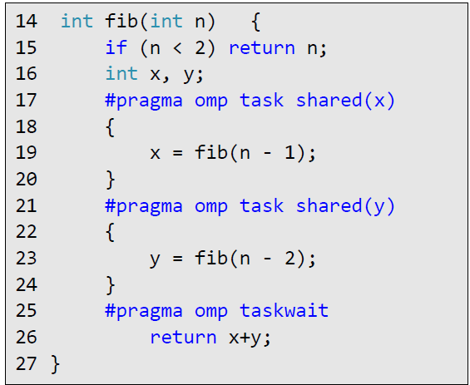
OpenMP: Task Synchronization
Only one thread executing #pragma omp single is responsible for creating tasks.
This thread creates the two initial tasks (line 17 and 21).
#pragma omp taskwait (line 25) is used to wait for the two tasks to complete. Otherwise, x and y would get lost.

Slide 28
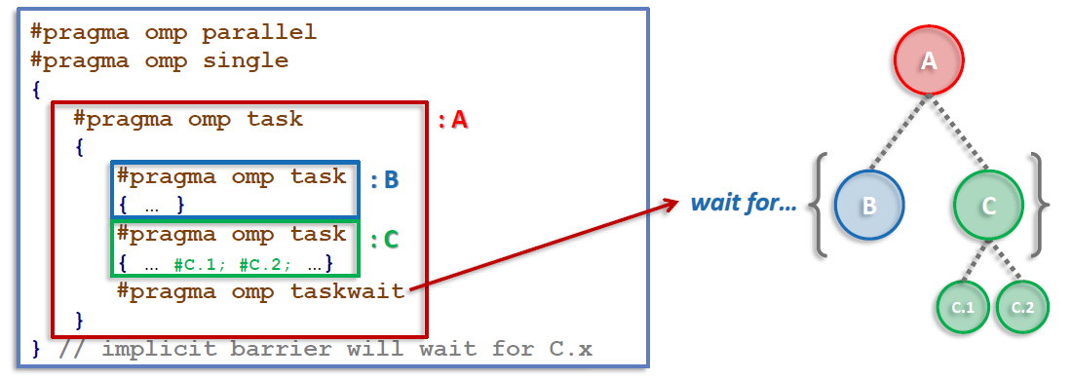
OpenMP: Task Synchronization
Figure Credit: C. Terboven PPCES 2021
Task C.1 and C.2 are not affected:
They can execute past #pragma omp taskwait without the need to wait.
#pragma omp taskwait only waits for Task B and C.
All tasks including C.1 and C.2 are guaranteed to have completed at the implicit barrier of the #pragma omp single.

Slide 29
OpenMP: Task Synchronization
Deep Task Synchronization:
Tasks can be synchronized across all descendant levels can be synchronized with #pragma omp taskgroup.
provides deep task synchronization.
The clause allowed is the task_reduction clause:
of the form task_reduction(reduction-identifier:list-items)

Slide 30
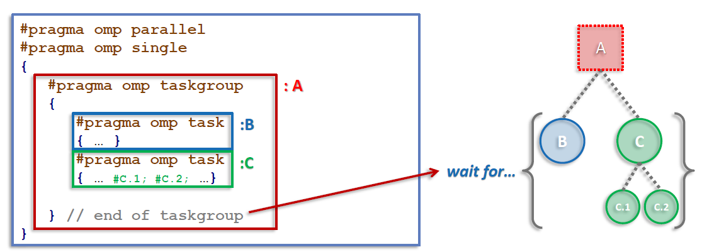
OpenMP: Task Synchronization
Figure Credit: C. Terboven PPCES 2021
Task C.1 and C.2 are affected:
They can not execute past #pragma omp taskwait without the need to wait.
All tasks, namely, B, C, C.1 and C.2 are guaranteed to have completed at the end of the #pragma omp taskgroup.

Slide 31
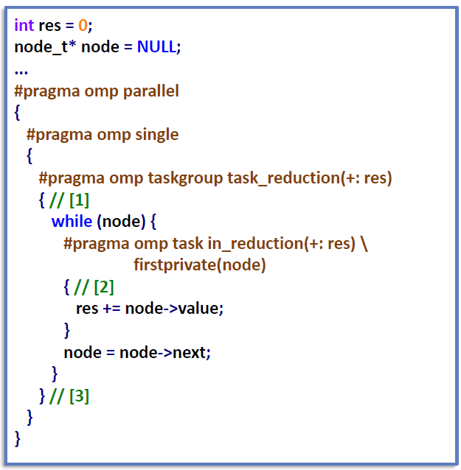
OpenMP: Task Reduction
The taskgroup-scoping reduction task_reduction clause
registers a new reduction at [1].
computes and make the final result available after [3].
The task in_reduction clause
allows the task to participle in the reduction operation [2]
introduced in OpenMP 5.0
Figure Credit: C. Terboven PPCES 2021

Slide 32
OpenMP: Cut-Off Strategies
For recursively defined divide-and-conquer algorithms, a cut-off can be defined to avoid task explosion.
Mechanisms:
Programmed cut-off mechanism by explicitly calling a function that does not create tasks
The if clause
The final clause
The mergeable clause

Slide 33
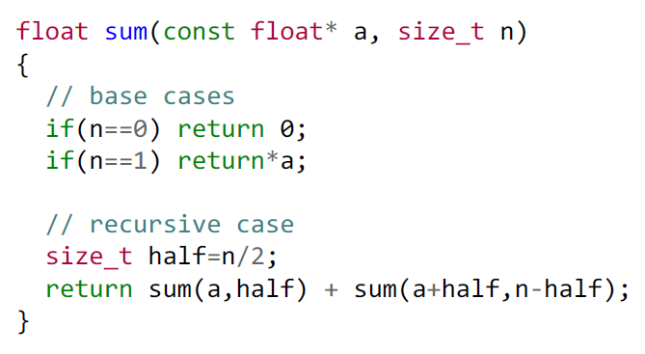
OpenMP: Programmed Cut-Off

Slide 34
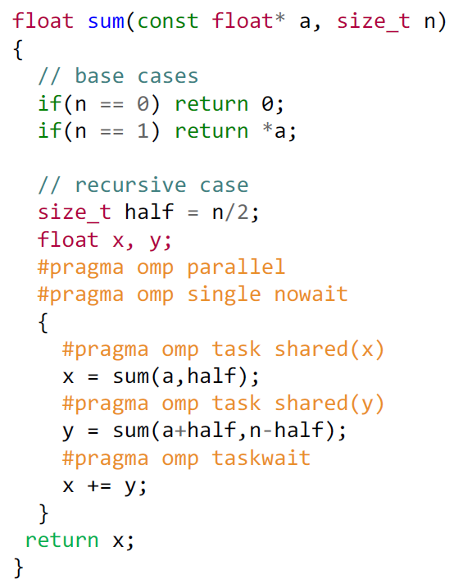
OpenMP: Programmed Cut-Off
The OpenMP code creates tasks recursively.
Problem:
The code creates too many small tasks, i.e., n is small.
Inefficient
Solution:
stop creating tasks at some cut-off threshold

Slide 35
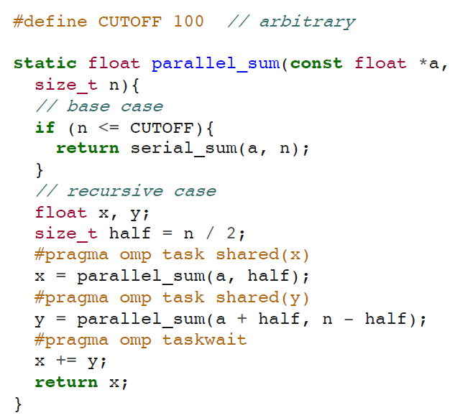
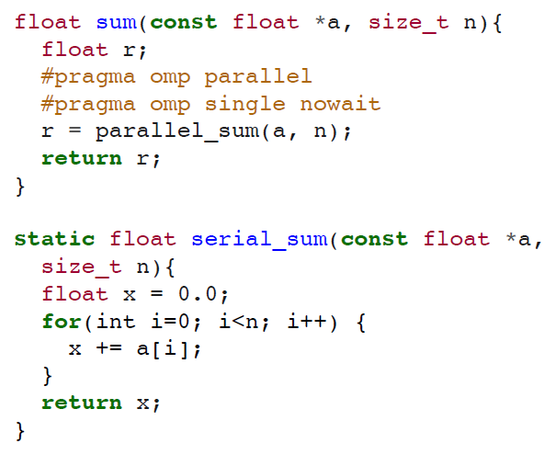
OpenMP: Programmed Cut-Off
Drawback: separate versions of sum !!!
serial_sum
parallel_sum

Slide 36
OpenMP: If Clause
If the if clause evaluates to false
the encountering task, i.e., parent, is suspended
the new task, i.e., child, is executed immediately
The new task is denoted as an “undeferred” task
the parent task resumes once the new task has completed
This feature can be used to improve the performance by avoiding queuing tasks that are too small.
The computational complexity of such small tasks may be considered too small and not worth the overhead for queuing them in the task pool.
The if clause does not affect the child tasks created by the encountering task.
This feature can be useful for debugging task-based OpenMP applications.

Slide 37
OpenMP: Final Clause
The final clause prevents the creation of further tasks if condition evaluates to true.
The purpose is to reduce overhead, which will also limit the degree of parallelism by preventing too many tasks from being created.
The new task is created and executed normally
However, in its context, its nested tasks will be executed immediately and sequentially by the same threads
The undeferred nested tasks are denoted as “included” tasks.

Slide 38
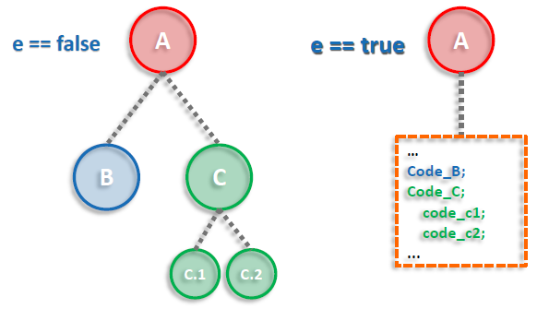
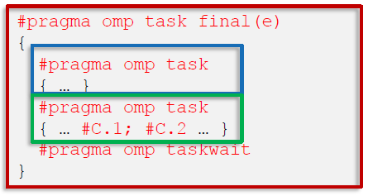
OpenMP: Final Clause
Figure Credit: C. Terboven PPCES 2021

Slide 39
OpenMP: Mergeable Clause
A task can be created mergeable if
it is an undeferred task OR
it is an included task
Its purpose is to
reduce OpenMP runtime overhead
inline the Data Environment to enable efficient data sharing
Often used with the final clause

Slide 40
Reference
[1] Ruud van der Pas, Eric Stotzer, and Christian Terboven. 2017. Using OpenMP -- The Next Step: Affinity, Accelerators, Tasking, and SIMD (1st. ed.). The MIT Press.
[2] Christian Terboven. 2021. Programming OpenMP. PPCES 2021.

